Slide 1
Popcorn
2018

Slide 2
In This Training You Will Learn…
Why We Are Selling Popcorn
How to Make Your Unit Successful
Learn the Different Ways to Sell
Get an Overview on Prizes and Other Incentives
Logistics and Timeline of 2018 Popcorn Campaign
Additional Resources to You

Slide 3
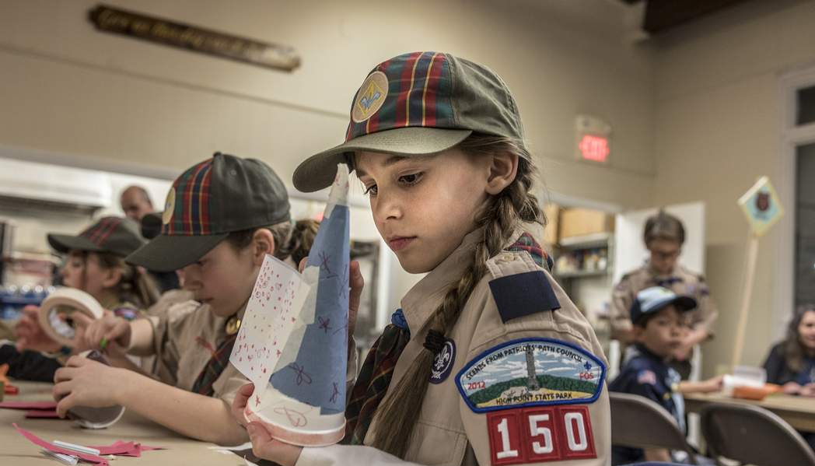
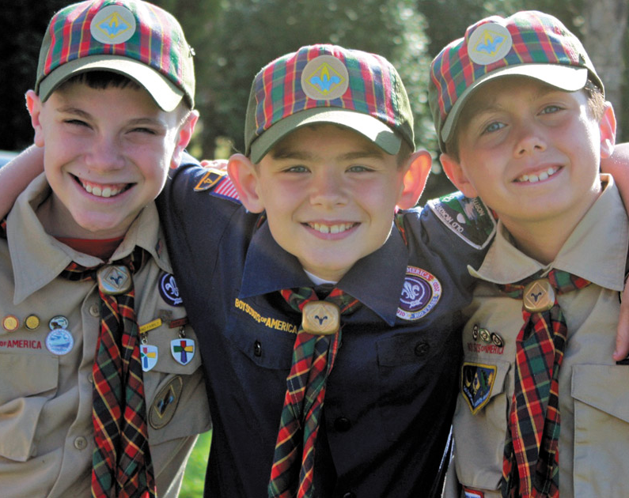
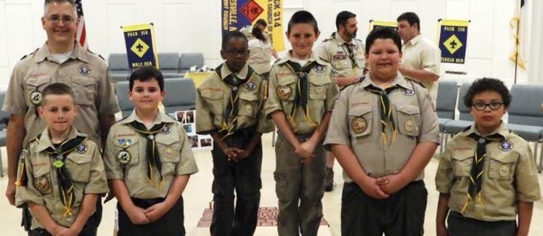
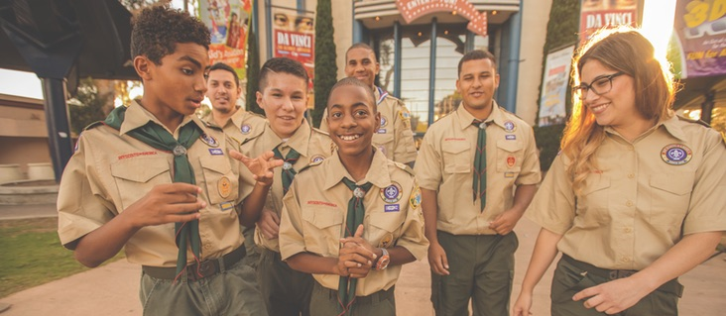
Notes:
Why do we sell popcorn? We sell popcorn so that these young people have this great program!

Slide 4
IT’S FOR THE SCOUTS
SHAC 2017 POPCORN UNIT COMMISSIONS $740,000+!
Scouts fundraise to earn their own way as well as provide the opportunity to fund their entire year in Scouting.
Provides Units the funding needed to execute a successful program year.

Slide 5
WHY TRAIL’S END POPCORN
OVER $4 BILLION RAISED FOR SCOUTING SINCE 1980
We have partnered with Boy Scouts of America Councils and Units to raise the funds needed to deliver the promise of Scouting for over 37 years.
Thank you!
Notes:
Trail’s End has a great track record of supporting local Scouting.

Slide 6
2 Ways to Sell
Take Order and Online Sales

Slide 7
Take-Order
TAKE-Order
Traditional way Scouts Sell Popcorn
Highest Dollar Average Per $ale
Highest Grossing Method
Notes:
This is the largest part of the 3 ways to sell accounting for almost $2 million dollars in retail sales or almost $600,000 back to units directly.

Slide 8
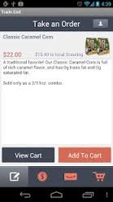
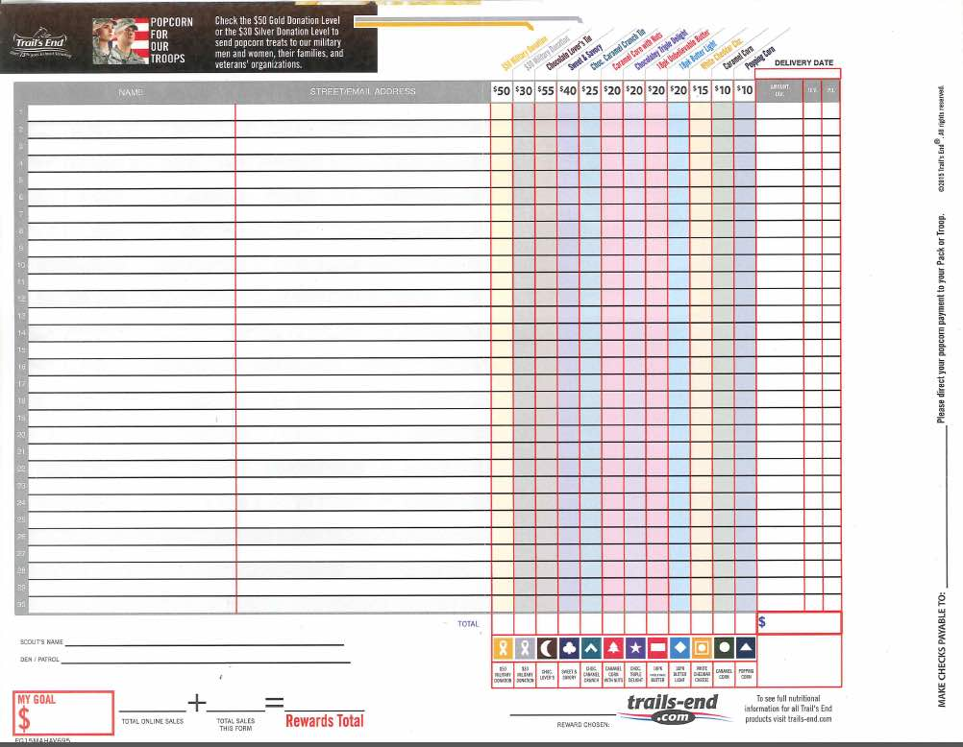
Options for Take Order………..
Download the Trails End App and take orders this way
Or traditional way - orders can be taken on order forms

Slide 9
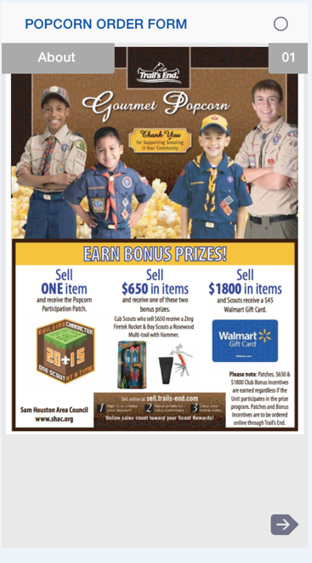
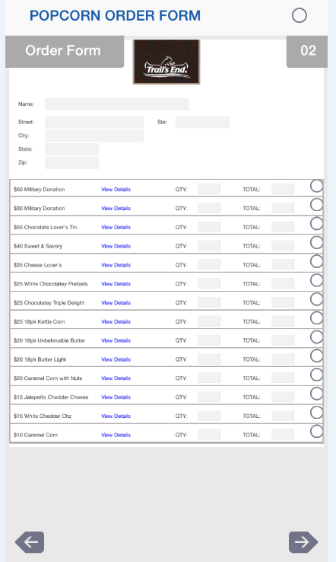
Trail’s End App
Trail’s End App
Mobile App by council w/their mix & pricing
Cascades to units & their Scouts’ phones
Take orders & CC payment in real time
Available in Apple App Store or Google Play
Instructions for setting up the app are at www.shac.org/popcorn/#Resources

Slide 10
FOR THE MILITARY
2018 POPCORN FUNDRAISER
Notes:
Military donation is for monetary donations that a unit may receive.
Very popular amongst Boy Scout troops and Venturing crews
Great way to raise funds, help support our troops, and never handle popcorn.

Slide 11
BLITZ DAYS
09/29/18
10/13/18
10/27/18

Slide 12
The winner will be drawn and announced on Facebook the following week.
September 29, 2018 – Sell a total of 20 total traditional items by 9/29/18
October 13, 2018 – Sell a total of 40 total traditional items by 10/13/18
October 27, 2018 – Sell a total of 60 total traditional items by 10/27/18
Go to council website (www.shac.org/popcorn/#Blitz) to find entry link.
All sales are cumulative
Multiple entries are allowed per Blitz Day
Scouts that meet the items sold count indicated by each date will qualify for entry into the drawing for one of three
GoPro Hero3+ Silver Edition.

Slide 13
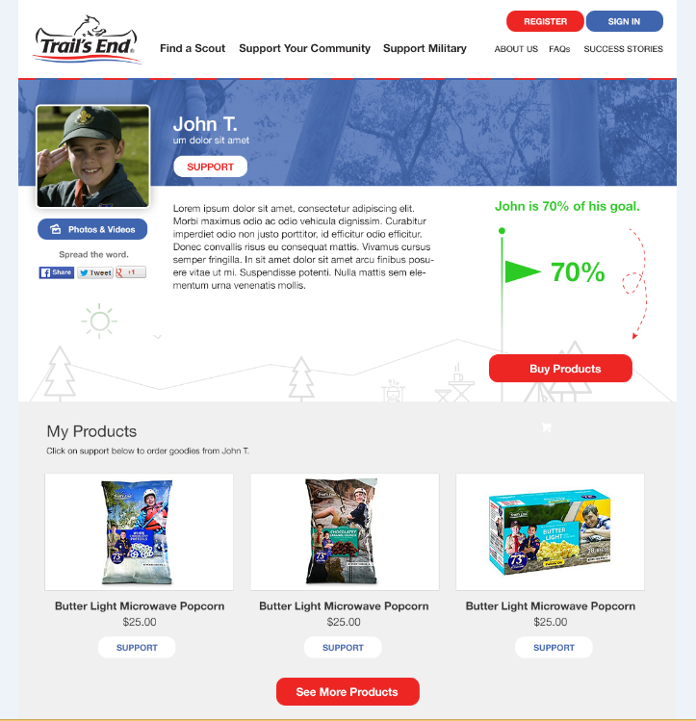
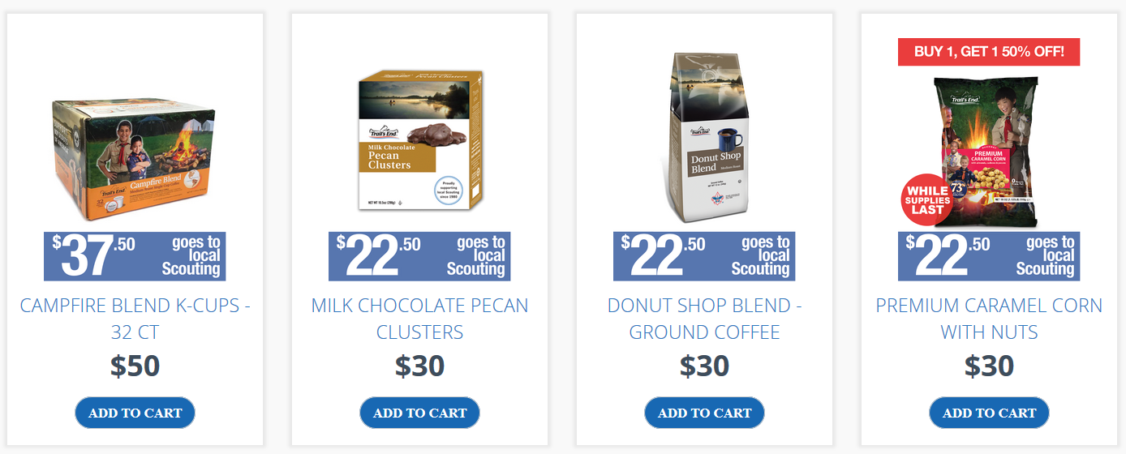
Online Selling
Personalized story
Simple to setup w/out help
Goal based & real time
Digital and social components drive viral possibilities
Notes:
In 2017 this doubled over the previous year. This is the easiest and fastest growing type of selling.
Remember that the scout, family, and unit do not have to handle any popcorn for online sales. IT IS MAILBOX MONEY!

Slide 14
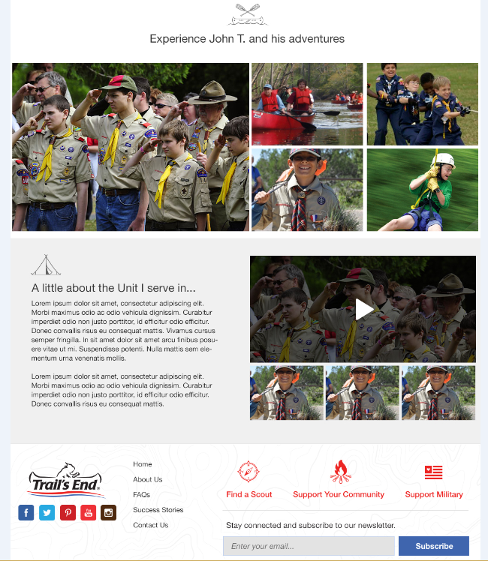
Online Selling
Scouts share their stories
Product line of products will be different
Serves as a testing ground for new TE products
Pricing will be different
Depends on prices for all councils across the country
Shipping
Notes:
A good time to do an extra push is when Trail’s End is doing a free shipping promotion which they have been known to do from time-to-time.

Slide 15
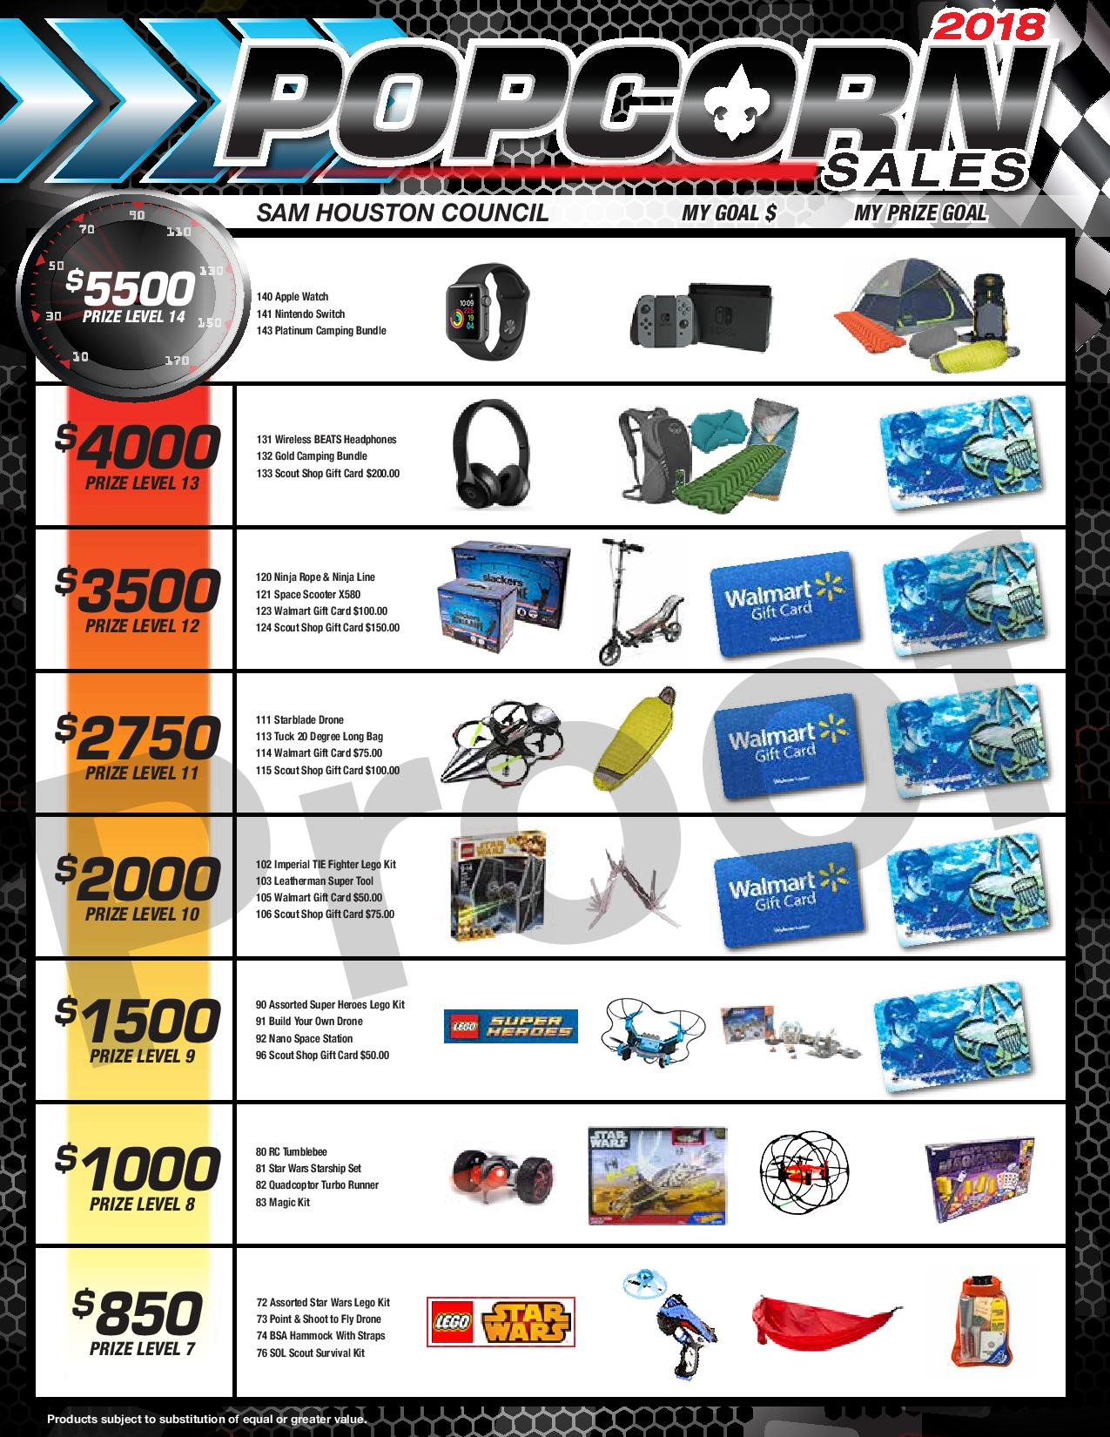
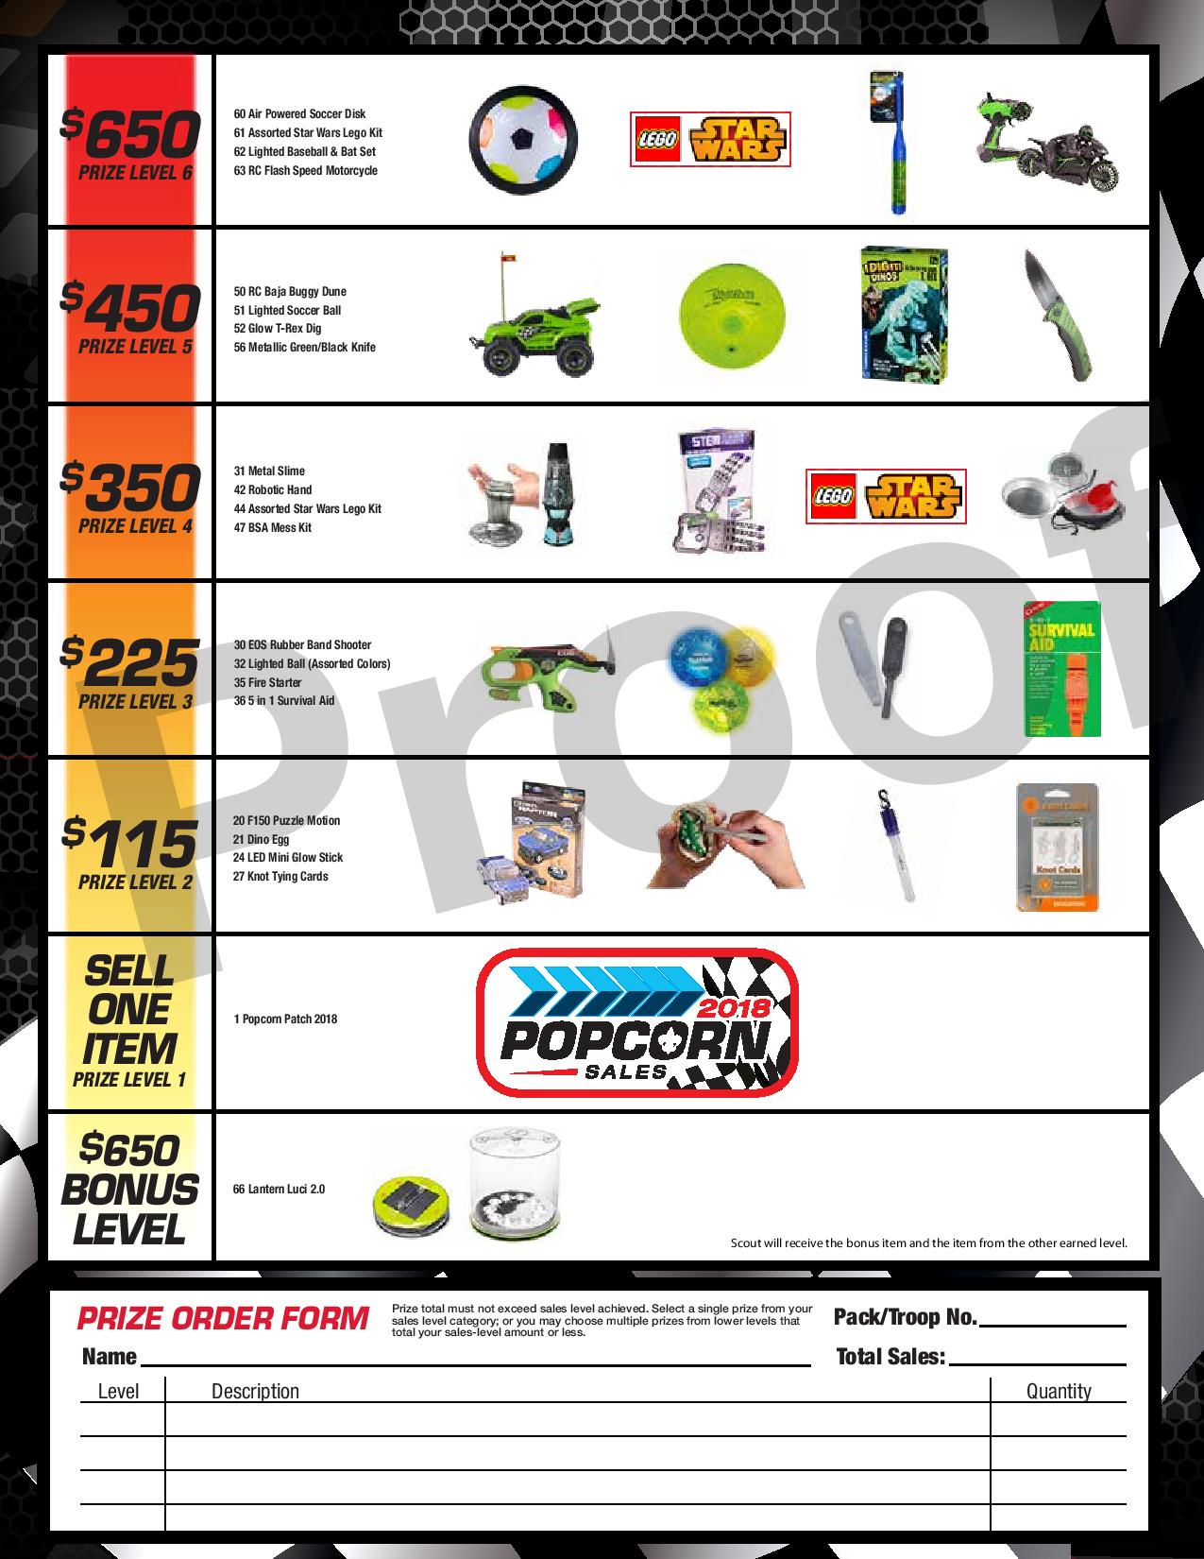
Notes:
These are in each of the packets you are receiving tonight after the training.

Slide 16
The Trail’s End Scholarship*
A Scout selling $2500 sold in one fall sale selling period (Show and Sell, Door-to-Door, Online) to qualify
6% of the retail goes into his “scholarship account”
Only have to hit $2500 once, all sales thereafter are eligible for the 6%
Accrues interest
Learn more at www.trails-end.com/scholarship
*Trail’s End Scholarship still applies even if a unit chooses not to do prizes.
Notes:
* If a person has a specific question get it offline *

Slide 17
SHAC SCOUT CHAMPIONS*
Trail’s End 2018 Top Seller Incentives
$ 1,000 - Movie (Scout + parent or guardian)
$ 1,500 - $ 50 Amazon eGift card + Movie + Dynamo Game
$ 2,500 - $ 150 Amazon eGift card + Movie + Dynamo Game
$ 3,500 - $ 250 Amazon eGift card + Movie + Dynamo Game
$ 5,000 - $ 400 Amazon eGift card + Movie + Dynamo Game
$10,000 - $1,000 Amazon eGift card + Movie + Dynamo Game
$15,000 - $1,500 Amazon eGift card + Movie + Dynamo Game
$20,000 - $2,000 Amazon eGift card + Movie + Dynamo Game
Movie: Lego Movie 2 (Feb 8 release date – attend that weekend)
Houston Dynamo: (2 tickets to a Dynamo or Dash soccer match)
*SHAC Scout Champions still applies even if a unit chooses not to do prizes.
Notes:
This is combined sales by scout (Show and Sell, Take Order, and Online)
In order to qualify sales must be entered BY SCOUT
This program takes the place of the top sellers party in January

Slide 18
Popcorn Ordering
Unit orders due online
by 10/30/18 @ 7:00 pm
Login to: scouting.trails-end.com
Click “Order Popcorn”
Follow the step-by-step instructions.
Orders from the app will be prepopulated
Notes:
Can’t stress enough those who setup the app will already have there orders in the system (don’t double enter)

